Slide 1

Welcome
LDS – LASER DETECT SYSTEMS
COMPREHENSIVE DETECTION SOLUTIONS
TECHNOLOGIES, APPLICATIONS, CONOP

Slide 2

LDS – Laser Detect Systems

Slide 3


LDS – LASER DETECT SYSTEMS
Established in 2004, Public in 2007.
Acquired and Privatized at 2010.
Subsidiaries & Business partners in US, Germany
R&D and Production In-House.
Risk assessments & Concept Of Operation design.

Slide 4




ABOUT US
Time Line
Founded In 2004
Public In 2009
Private In 2010
Wide Distribution 2015
Products & Solutions
Detectors
Detection Products
Integrated Solutions
Technology
Lasers
IMS
Chemicals
Market
R&D
Military
Security & HLS

Slide 5
OUR MISSION
Lasers
IMS
Chemicals
Under Vehicle Inspection
TECHNOLOGY
Explosives
Precursors
Drugs
Poisons
Traces
Vapors
Liquids & Gels
CAPABILITIES
Risk Analysis
Site Surveys
CONOP
Training
Intelligence/
Interception
CONOPS
From Detection to Interception

Slide 6
HLS Mobile Hazmat Detectors Range of Solutions (Advantages & Limitations)
Do Nothing
Accurate
Sniffers
Limited database
Human factor
Accurate, Certified
Chemical testers
Rapid flow
No cost
Minimum inconvenient
High Risk
Low cost
Human factor
Expiry date
Environment sensitive
Not relevant for liquids
Laboratories
Not in real time
Expensive
FTIR
Waiting list
Raman
Accurate, Fast
Excels with Liquids
Extendable DB,10k+
Accurate
No Traces & Vapors
Preparations
Water
Fluorescence

Slide 7
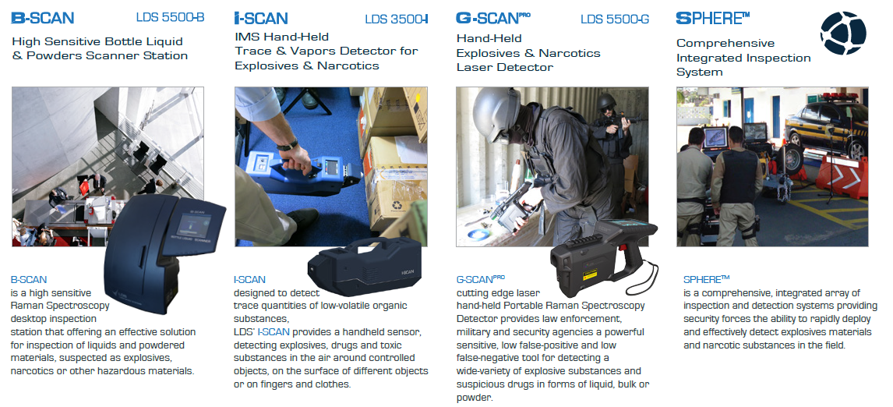
COMPREHENSIVE DETECTION SOLUTIONS

Slide 8






APPLICATIONS
Check points & Borders
Mass crowd
Events
Airports Security
Customs inspection
Seaport
security
Mass Transportation
Critical Infrastructure Protection

Slide 9

Products Review

Slide 10
G-SCAN^{PRO}
HANDHELD HAZARDOUS SUBSTANCES LASER DETECTOR
532nm Green laser with Fluorescence compensation algorithm
Explosives, Precursors, Narcotics - liquids, bulks or powders
Real time, Rapid results ~5sec
Highly Operational & Light weight <1.85kg
Long operating time >8 hrs
Ready to go immediately [No warmup time]
Minimal maintenance
Extendable database [Locally, Externally]
Not effected by external Environment

Slide 11
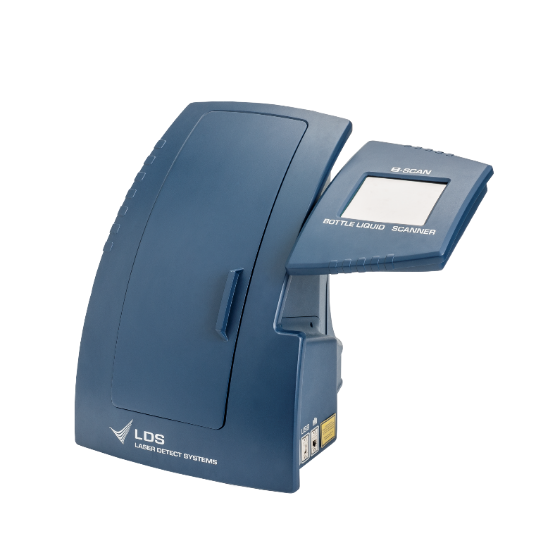
B-SCAN BOTTLE LIQUIDS & POWDERS LASER SCANNER STATION
Detection of wide variety of hazardous substances in forms of liquid, bulk or powder
Real time, Rapid results ~5sec
Desktop stationary design
Operates via Electricity or backup battery
Ready to go immediately. No warmup time
Minimal maintenance
Extendable database. Locally, Externally
Not effected by external Environment

Slide 12
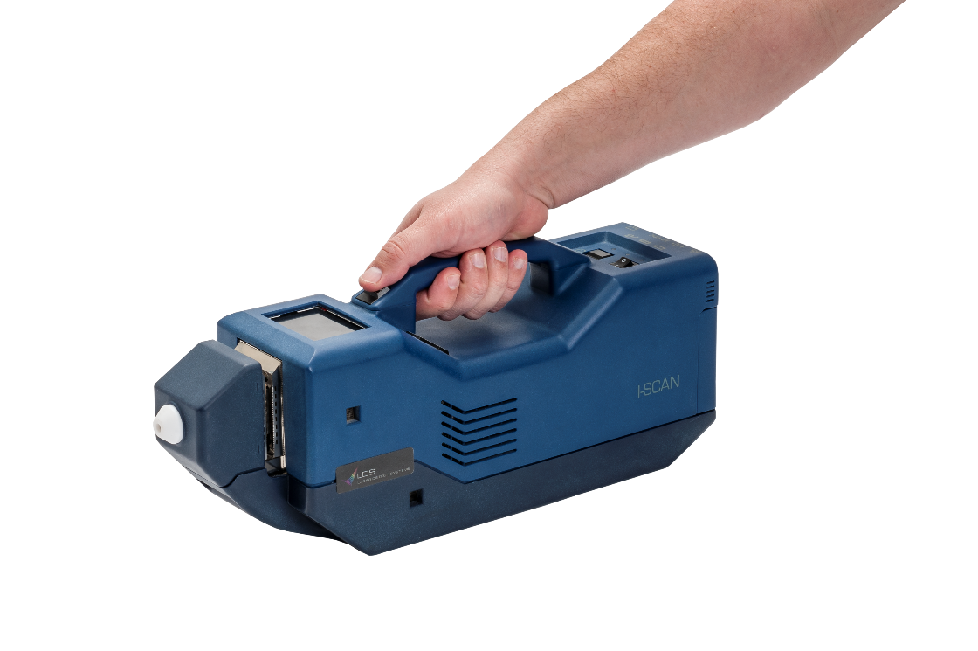
I-SCAN HANDHELD ION MOBILITY SPECTROMETRY (IMS) TRACES & VAPOURS DETECTOR
Detection of wide variety of hazardous substances in forms of Vapours and Traces
Highly sensitive
Detection within seconds
None radioactive ionization source
Dual technics – Traces (Swabbing) or Vapors
Dual mode – Explosives and Narcotics
Efficient consumables usage
Operating time >4 hrs

Slide 13
Concept of Operation

Slide 14

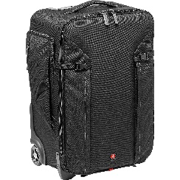
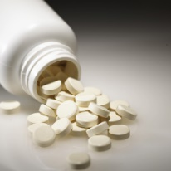
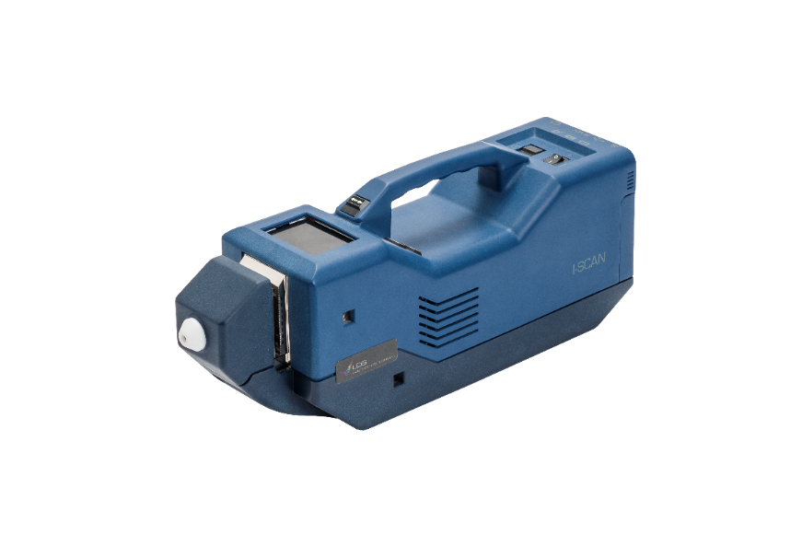
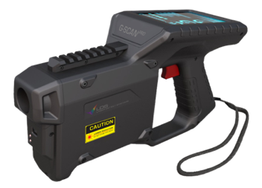
Concept of Operation
Inspection of suspected:
Bags
Boxes
Persons
I-SCAN
Inspection of suspected:
Liquids
Powders
bulks
G-SCAN

Slide 15
Laser Technology Review

Slide 16
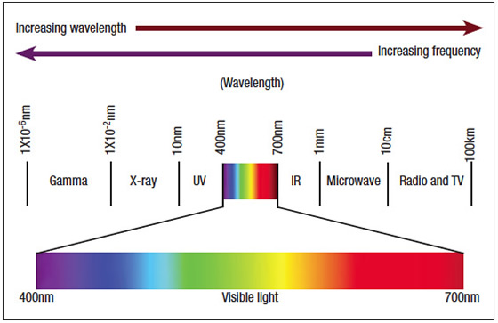


LASER IDENTIFICATION PROCESS
Engagement
01
A laser source illuminates the suspected material.
The light strikes the molecules and scatters.
The scattered light is collected by the spectrometer.

Slide 17

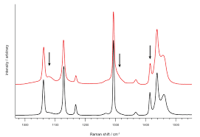
LASER IDENTIFICATION PROCESS
Analysis
02
Molecular fingerprint is generated
(Raman spectra).
The spectrum is compared with previously recorded Raman signatures of various substances.

Slide 18
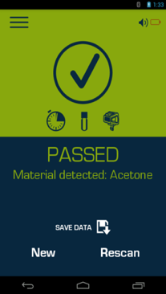
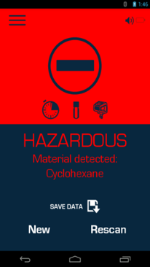
LASER IDENTIFICATION PROCESS
Outcome
03
The computing unit generates True / False result.
A match alerts the operator of hazardous substances residue.

Slide 19
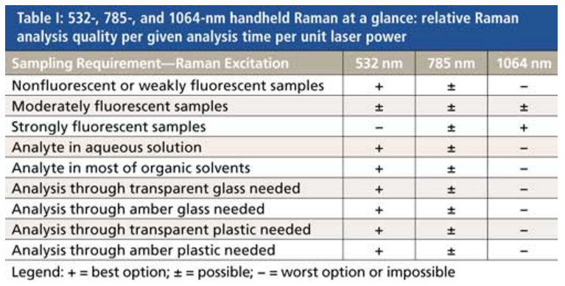
Portable Raman Detectors – Wavelength aspect
Excitation at 532nm known to have strong Raman signal alongside unwanted fluorescence background.
Strong Raman signal results to improved Analysis speed and Accuracy.
For portable applications Green laser Raman excitation is with the most benefits assuming efficient fluorescence compensating (noise reduction).
http://www.spectroscopyonline.com/recent-developments-handheld-raman-instrumentation-industry-pharma-police-and-homeland-security-532

Slide 20

LDS Unique Identification Technology
LDS Raman technology utilizes a Green laser source and proprietary analysis algorithms backed by efficient fluorescence compensating mechanism.
Harnessing 532nm excitation with low SNR allows LDS the use of low power laser (<30mw)
Highly accurate
Immediate detection (~5 sec)
Fully automated analysis
Tailored to outdoor operation
Low false alarm rate
No consumables, No calibration
>8 hrs operating time
No hitting of the object, Safety
Identification through sealed containers
Identification of liquid, bulk & powder
No warmup time
Performance unaffected by environmental conditions
No contamination

Slide 21
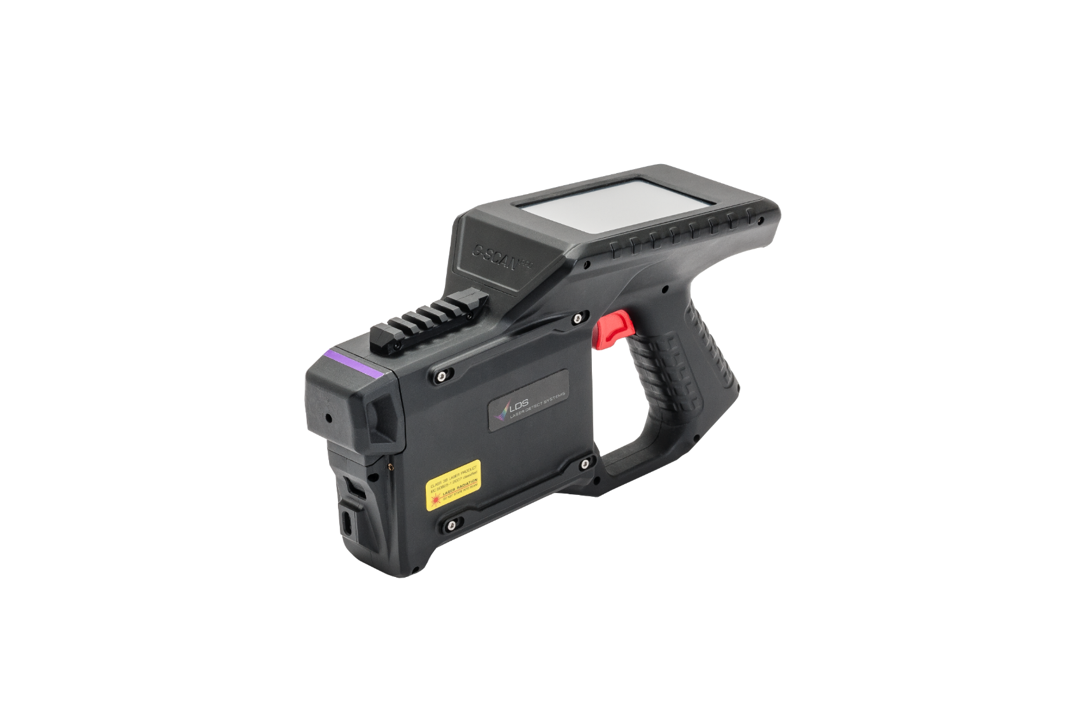
G-SCAN^{PRO}

Slide 22
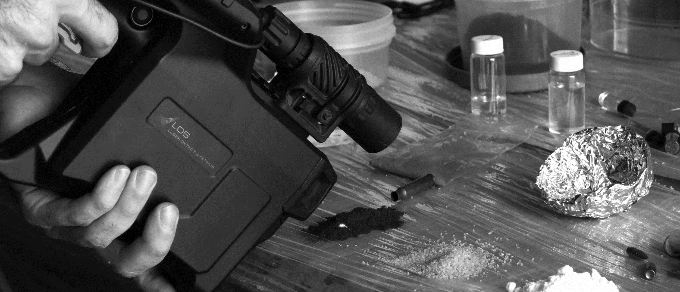
Laser Technology THE CHALLENGE
Identification & detection of substances that looks INNOCENT
But may contain
DANGEROUS SUBSTANCES

Slide 23


Laser Technology THE CHALLENGE
Or are there liquid explosive mixed?
Is This Water?
Does this pill contain only paracetamol?
Or a mixture of large amount of cocaine
Is it only sugar?
Or massive amount of heroine is inside

Slide 24

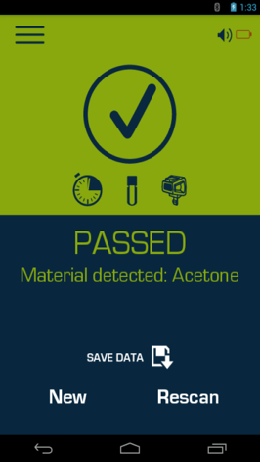
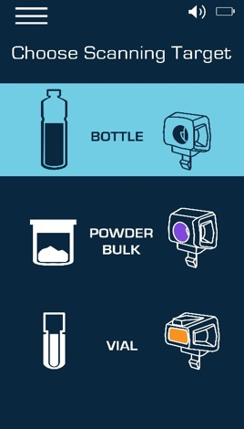
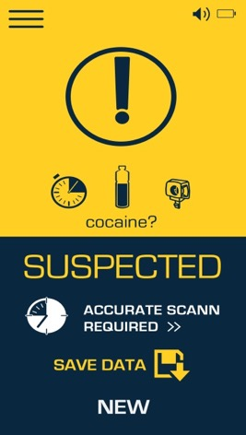
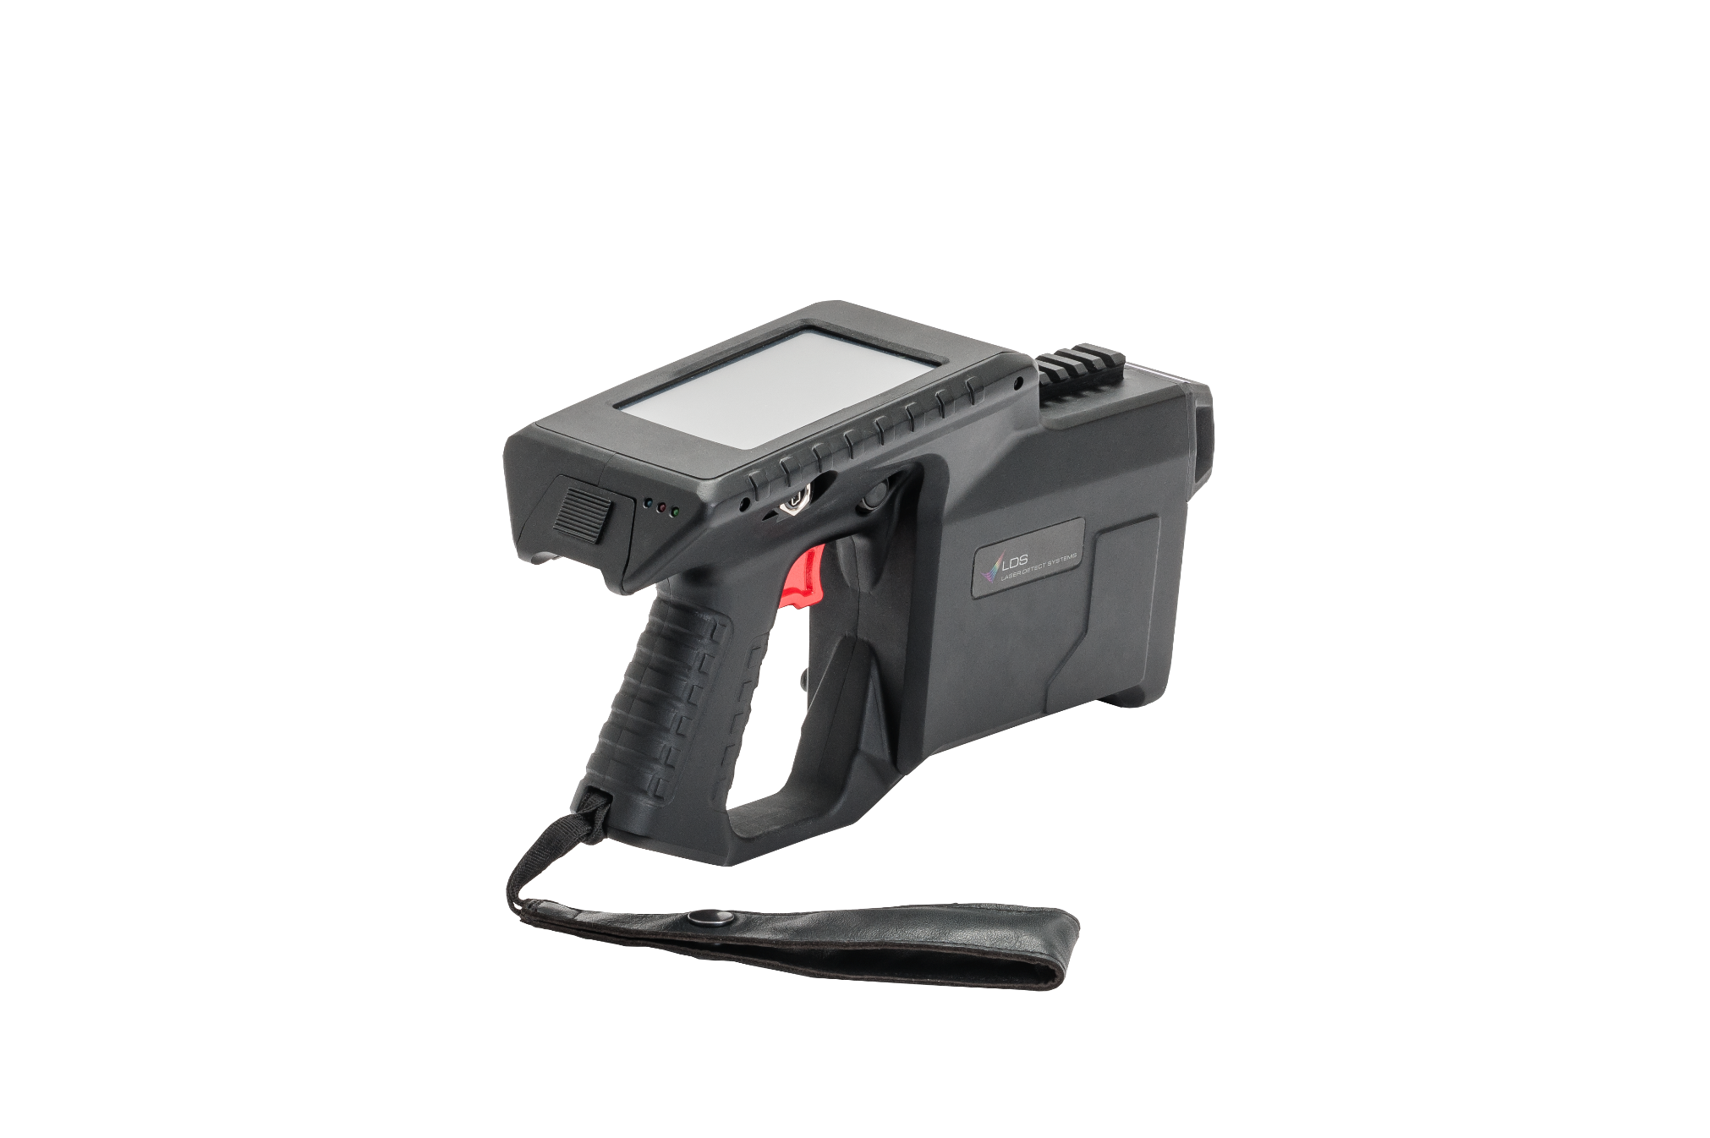

INTUATIVE USER INTERFACES
User level
Simple Operation
Visible and vocal

Slide 25

INTUATIVE USER INTERFACES
Professional level
Analysis of the Raman Graphs is available with sophisticated Analysis software

Slide 26

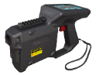

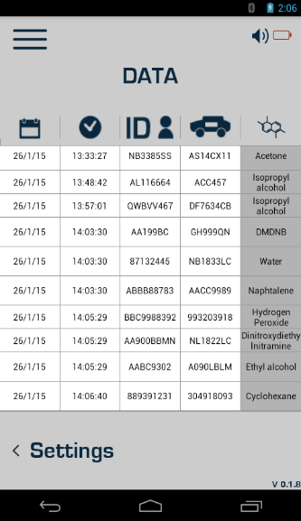


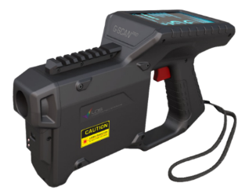
LOG EVENT
Intelligence Center
Enter password
Fill out the report
Data is saved on cloud

Slide 27
Unique Selling Points

Slide 28
Laser compere to IMS
Advantages
No Warn up- immediately ready to work.
No consumables.
No Calibration.
Minimal environmental effect at the outdoor.
New operational concept – Deterrence.
Liquids (+ Bulk & Powders).
Via sealed semitransparent Container.
Limitations:
No gas- completers technology
No traces
Need to have direct sight to the suspected item.

Slide 29





Device level- advantages
Quick analysis time. Laser type
Via Container
Substances Library
Outdoor, Highly operational (SwaP, Design)
Wide. Unique
Extendable (Hugh)
Upgradeable
Liquids (+ Bulk & Powders)

Slide 30
G-Scan pro
Learning Technology
Adjusting Database to the new challenges

Slide 31
EXTENDABLE DATABASE
Locally.
Externally.

Slide 32
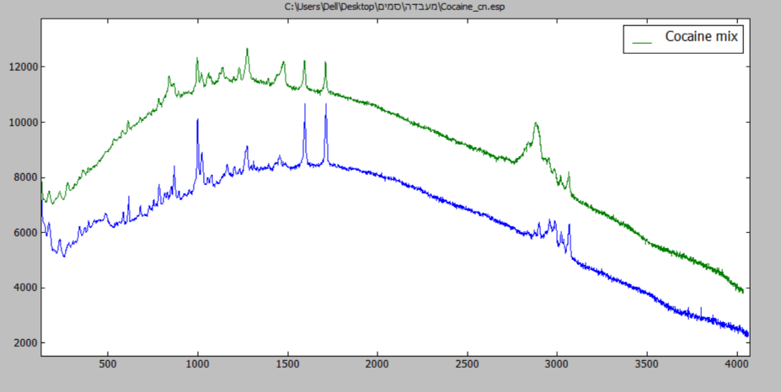
Database localization- background
Different substances around the world behave differently.
Though some of them might contain the same components in most cases the molecular level has some differences.

Slide 33
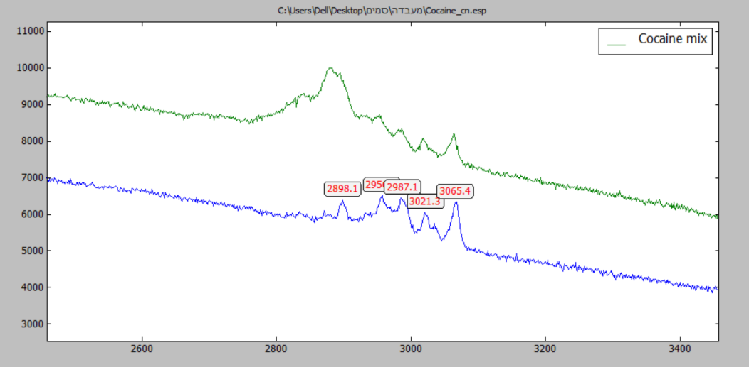
What is different in the substances
Like each person is different from another by:
ID number
Passport number
Phone number
Mail box
Name?
Substances might be different from each other in hundred parameters.
01

Slide 34

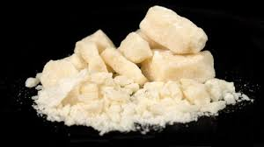
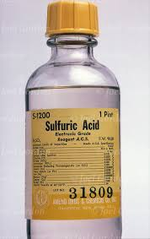
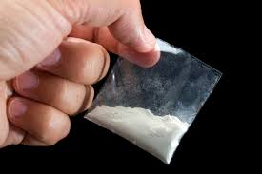
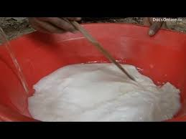
Process of producing Cocaine
Take the plant Coca and make a paste out of it
Take the chemical liquid- sulfuric Acid.
Mix it
Liquid that looks like milk
Dehydrate it
This is cocainium chlorate
Each dealer mix this pure powder with different substances:
Benzocaine
Sugar
Salt
Flour
Toxics
This creates different types of ID’s for every region.
+ ?

Slide 35
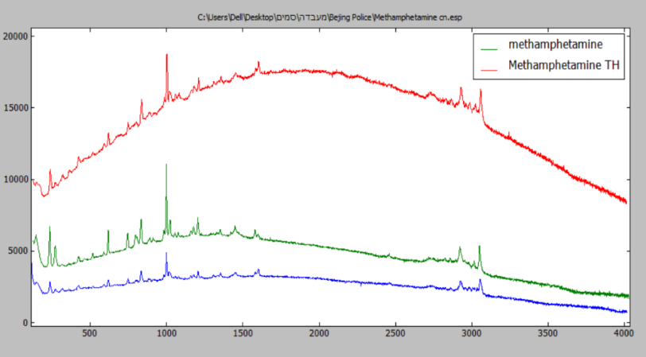
EX: Methamphetamine
The graph to the left poses three types of Methamphetamine. 2 from the east and one from Israel. The algorithm output is that the 2 from the east has very similar molecular level unlike the one from Israel that is completely different.
This is due to the following reasons:
Different luminescence background.
Picks ratios.
X’s value shift to common picks.
New Raman picks

Slide 36
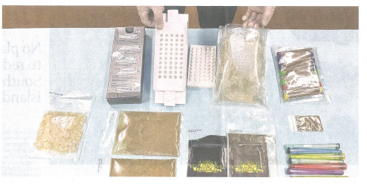
Controlling the new threats in the streets
Provided with a computer software for advanced analysis the G-Scan pro is able to adapt itself into new threats.
In many regions new types of “street drugs” are rapidly created. G-Scan pro is able to identify pills, powder and liquids and identify the similarity to known substances.
If the substance is new to the device?
Teaching the G-Scan is easy and intuitive.
G-Scan can also adapt its capabilities to detect new drugs precursors.

Slide 37
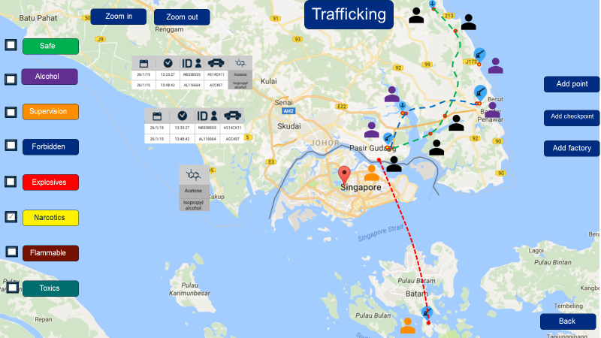
Creating situational awareness
Exporting data from different G-Scan deployed around the country provides low enforcement's with the full picture of drugs trafficking around the state.
Data from the G-Scan can be transferred via E-mail over night and be operative for all the detector deployed.
This communication method assists with creating situational awareness for drugs trafficking.

Slide 38
I-SCAN^{MK2}

Slide 39
i-Scan Mk.2 HANDHELD ION MOBILITY SPECTROMETRY (IMS) TRACES & VAPOURS DETECTOR
Detection of wide variety of hazardous substances in forms of Vapours and Traces
Highly sensitive
Detection within seconds
None radioactive ionization source
Dual technics – Traces (Swabbing) or Vapors
Simultaneous detection– Explosives and Narcotics
Efficient consumables usage
Operating time >4 hrs

Slide 40

New i-Scan Mk.2 introduction
i-Scan Mk.2 applies the principles of state of the art Ion Mobility Spectrometry (IMS).
This detection process is based upon division of ions in substances according to their mobility during movement in the drift tube in the constant electric field.

Slide 41


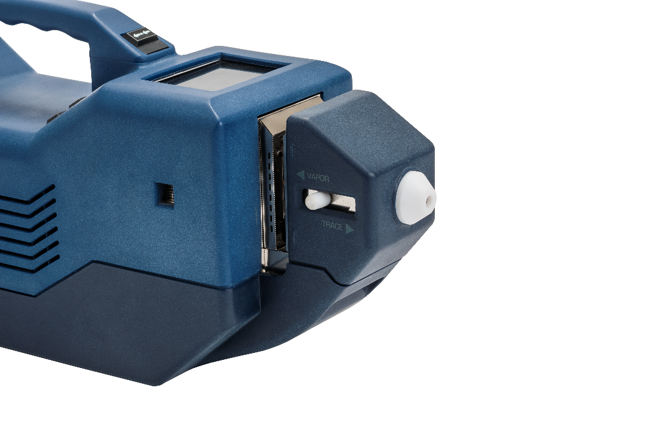
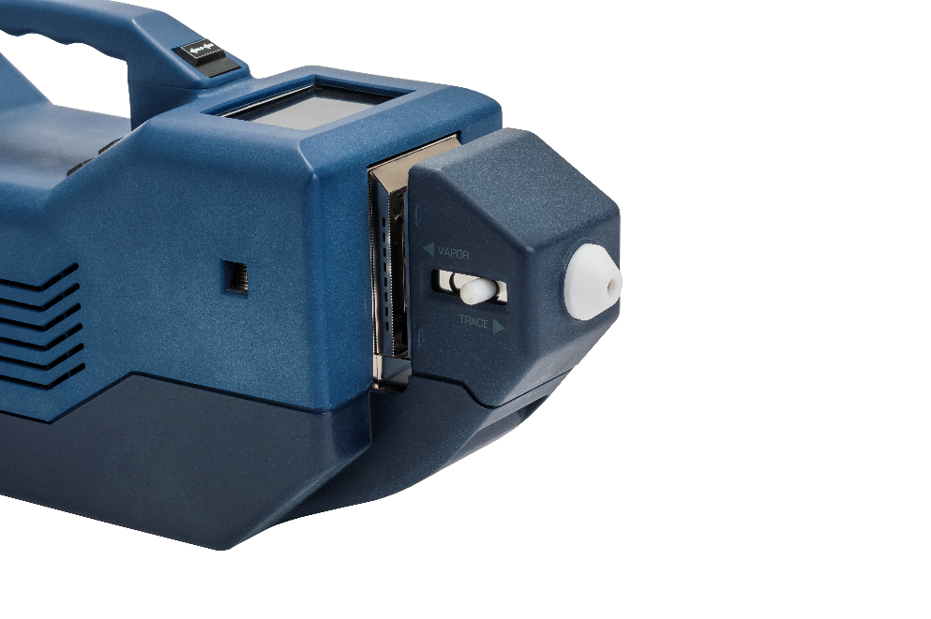
New i-Scan Mk.2 detection capabilities
In forms of:
Vapors Traces
Detection & Identification of:
Drugs;
Explosives;
Toxic industrial chemicals
Chemical warfare agents
Highest sensitivity in the market: 1.0х10-14 g/сm3 (Vapors) 1.0х10-11 g (traces)

Slide 42
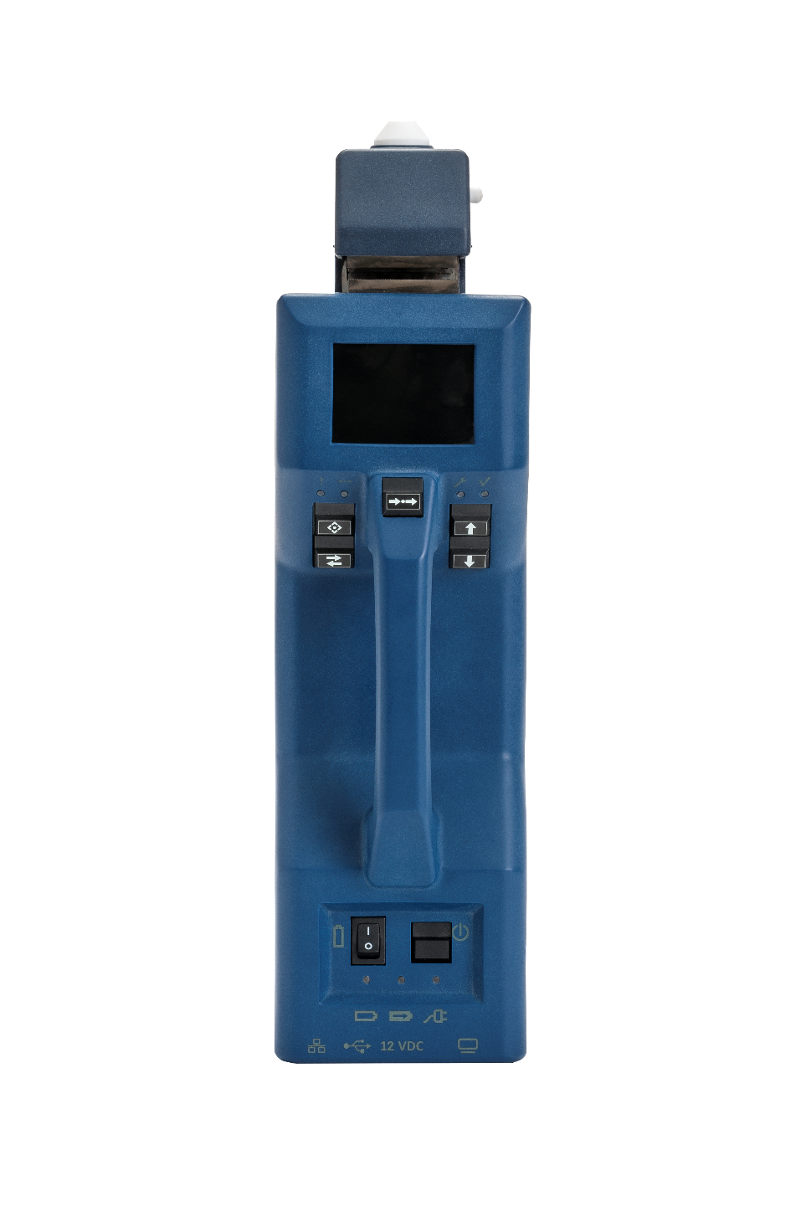


How it works?
Continuously sampling the air surrounding object being inspected at the speed 5-10 сm³/s.
sampling air containing molecules from the target and passing these into the ionization source using an impulse
corona discharge, where molecules are being partially ionized.
“Corona discharge”
chamber
Ion mobility
spectrometer

Slide 43
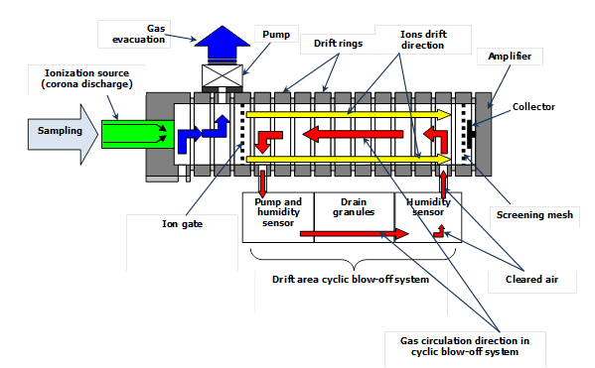
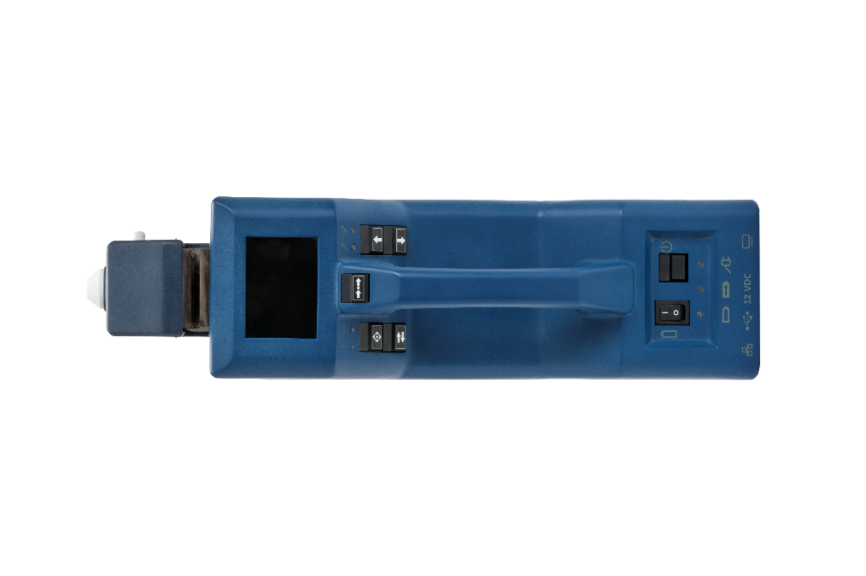
Unique ionization process- “Corona Discharge”
“Corona discharge” ionization process benefits the device with low consumables expenses:
Low filter, molecular sieves consumption
8 hours using the same aluminum foil swabbing instrument
Non-Radio active source

Slide 44


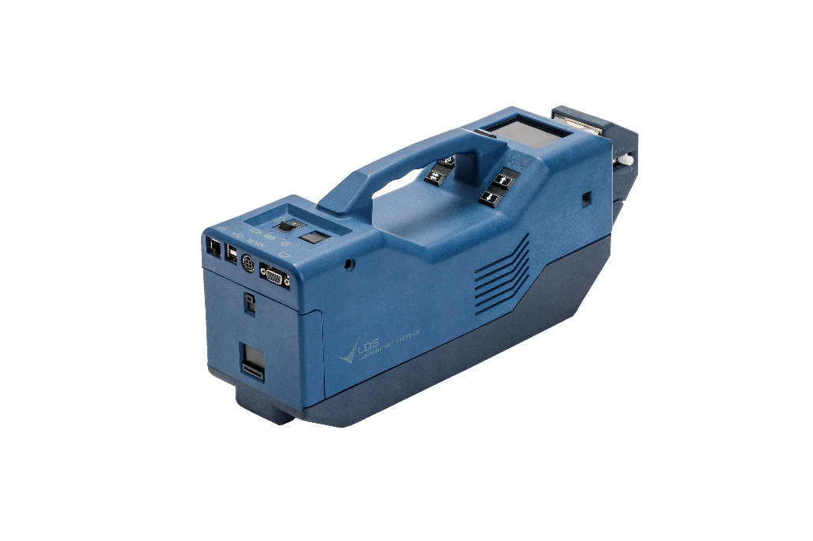

Simultaneous detection
Each material holds negative or positive ions polarity. Until now, operator had to select in advance which polarity to look for. LDS I-SCAN 3600-I offers:
Detects both positive and negative Ions at the same time: Performing the ionization (+ & -) process at the same time and complete the security requirements.
Detection of all types of explosives in one inspection: Most of explosives holds negative polarity while many popular homemade explosives such as TATP (Triacetone-Triperoxide) holds positive polarity.

Slide 45
Large database with peroxide base homemade explosives
№ | Full name | Marker | Chemical formula
List of drugs detected by I-SCAN *
1 | Amphetamine | AMP | C₉H₁₃N
2 | Methamphetamine | MET | C₁₀H₁₅N
3 | Cocaine | COCB, COCS | C₁₇H₂₁NO₄
4 | Heroin (diacetylmorphine) | HER | C₂₁H₂₃NO₅
5 | Tetrahydrocannabinol (psychoactive constituent of the cannabis plant) | THC | C₂₁H₃₀O₂
6 | Methylenedioxyamphetamine (“Sassafras”) | MDA | C₁₀H₁₃NO₂
7 | Methylenedioxymethamphetamine (“Ecstasy”) | MDMA | C₁₁H₁₅NO₂
8 | Phenobarbital | PHNB | C₁₂H₁₂N₂O₃
9 | Morphine | MORP | C₁₇H₁₉NO₃
10 | Codeine | CODN | C₁₈H₂₁NO₃
№ | Full name | Marker | Chemical formula
List of explosives detected by I-SCAN *
1 | Ammonium nitrate | NIT | NH₄NO₃
2 | Dinitrotoluene | DNT | C₆Н₃CH₃(NO₂)₂
3 | Trinitrotoluene | TNT | C₆Н₂CH₃(NO₂)₃
4 | Trinitroresorcinol (styphnic acid) | TNR | C₆H(NO₂)₃(OH)₂
5 | Trinitrophenol (picric acid) | TNPH | C₆H₂(NO₂)₃OH
6 | Dinitronaphthalene | DNN | C₁₀H₆(NO₂)₂
7 | Dimethyldinitrobutane | DMNB | СH₃(NO₂CCH₃)₂CH₃
8 | Ethyleneglycoldinitrate | EGDN | C₂Н₄(ОNO₂)₂
9 | Nitroglycerine | NG | CHONO₂(CH₂ONO₂)₂
10 | Pentaerythritol tetranitrate (penthrite) | PETN | (CH₂ONO₂)₄C
11 | Hexogen (RDX) | RDX | (CH₂)₃N₃(NO₂)₃
12 | Octogen (HMX) | HMX | (CH₂)₄N₄(NO₂)₄
13 | Tetryl | TETR | (NO₂)₃C₆H₂N(NO₂)CH₃
14 | Tetrazole | TZ | СH₂N₄
15 | Benzofuroxan | BF | С₆H₄O₂N₂
16 | Triacetone triperoxide | TATP | (C₃H₆O₂)₃
17 | Hexamethylene triperoxide diamine | HMTD | N(CH₂OOCH₂)₃N
18 | Plastic explosives based on hexogen (RDX) (hexogen+plasticiser) | RDX | Prev. (CH₂)₃N₃(NO₂)₃
19 | Plastic explosives based on octogen (HMX) (octogen+plasticiser) | HMX | Prev. (CH₂)₄N₄(NO₂)₄
20 | Octol (HMX+TNT) | HMX, TNT | Mixture
21 | Semtex (RDX+PETN+ plasticiser) | RDX, PETN | Mixture
22 | Ammonite, amatol | TNT, NIT, (RDX) | Mixture
List of toxic chemicals detected by I-SCAN *
1 | Hydrogen sulfide | H2S | H₂S
2 | Hydrogen chloride | HCL | HCl
3 | Hydrogen fluoride | HF | HF
4 | Sulfur dioxide | SO2 | SO₂
5 | Chlorine | CL2 | Cl₂
6 | Ammonia | NH3 | NH₃
7 | Nitrogen oxide | NO | NO
8 | Nitrogen dioxide | NO2 | NO₂
1 | Sarin | GB | C₄H₁₀FO₂P
2 | Soman | GD | C₇H₁₆FO₂P
3 | Mustard gas | MG | C₄H₈Cl₂S
4 | Vx | VX | C₁₁H₂₆NO₂PS
5 | Phosgene | CG | CCl₂O
6 | Hydrocyanic acid | HCN | HCN

Slide 46
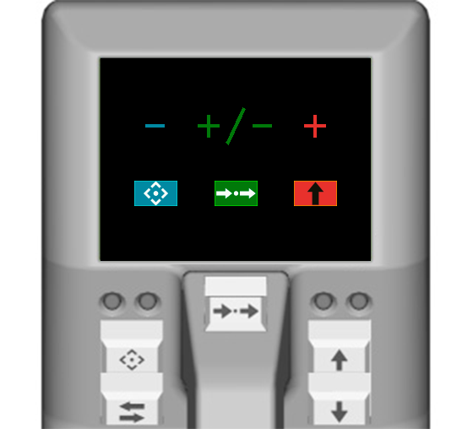
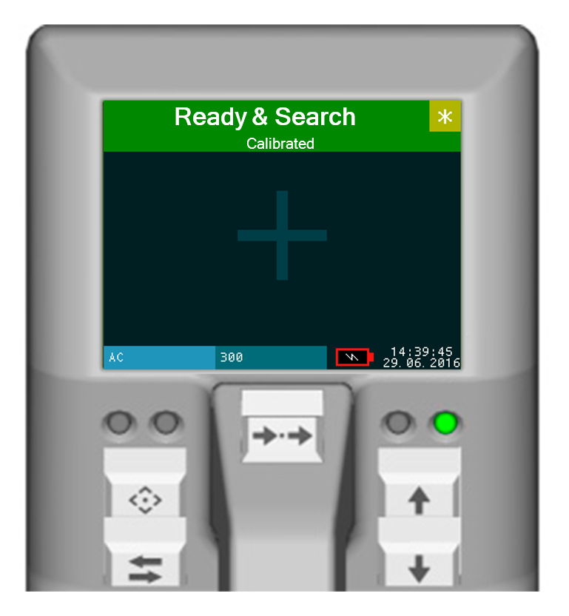
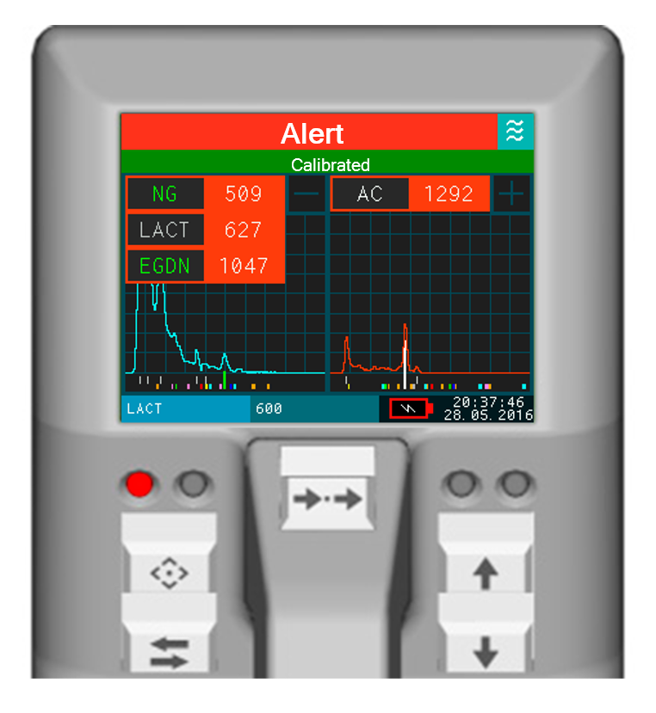
Friendly & intuitive user interface
The new user interface allows the operator to operate the device intuitively with no requirement of understanding graphs.
Choose polarity

Slide 47

Easy to carry and operate
1 – Current working mode (similar to upper line on detector LСD display).
2 – Main sensors current status.
3 – Spectrogram of ions drift in coordinates “drift time”/“ADC units”.
4 – Peaks positions of target substances on the time scale.
5 – Calibration status.
6 – Markers of the ‘target’ substances and corresponding response thresholds.
7 – Markers of the found substances (up to five for each polarity) and their peak heights.
8 – Current system frequency (measurements per second).
9 – Total operating time (in hours).

Slide 48
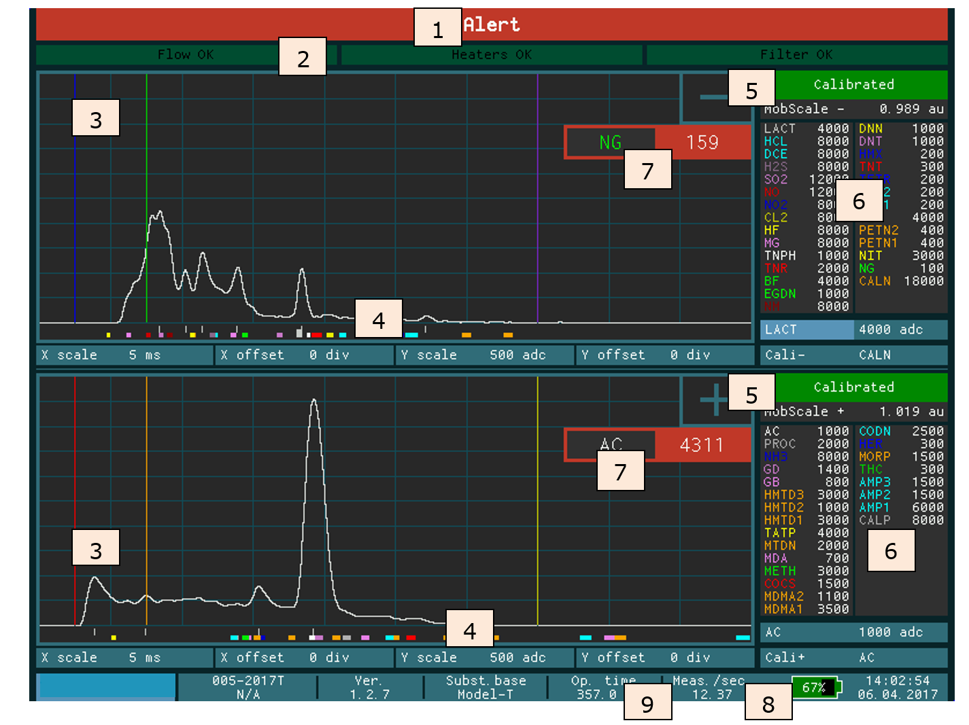
Computer display of analysis parameter
1 – Current working mode (similar to upper line on detector LСD display).
2 – Main sensors current status.
3 – Spectrogram of ions drift in coordinates “drift time”/“ADC units”.
4 – Peaks positions of target substances on the time scale.
5 – Calibration status.
6 – Markers of the ‘target’ substances and corresponding response thresholds.
7 – Markers of the found substances (up to five for each polarity) and their peak heights.
8 – Current system frequency (measurements per second).
9 – Total operating time (in hours).

Slide 49
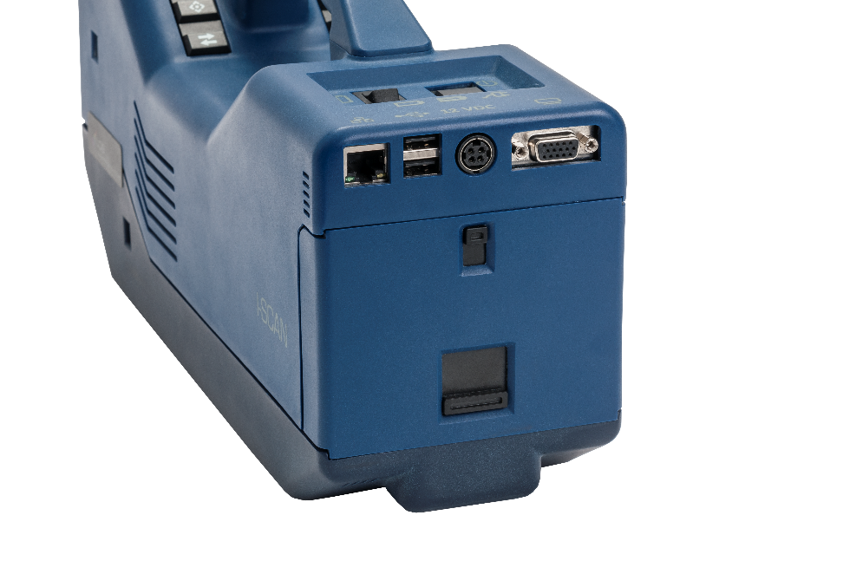
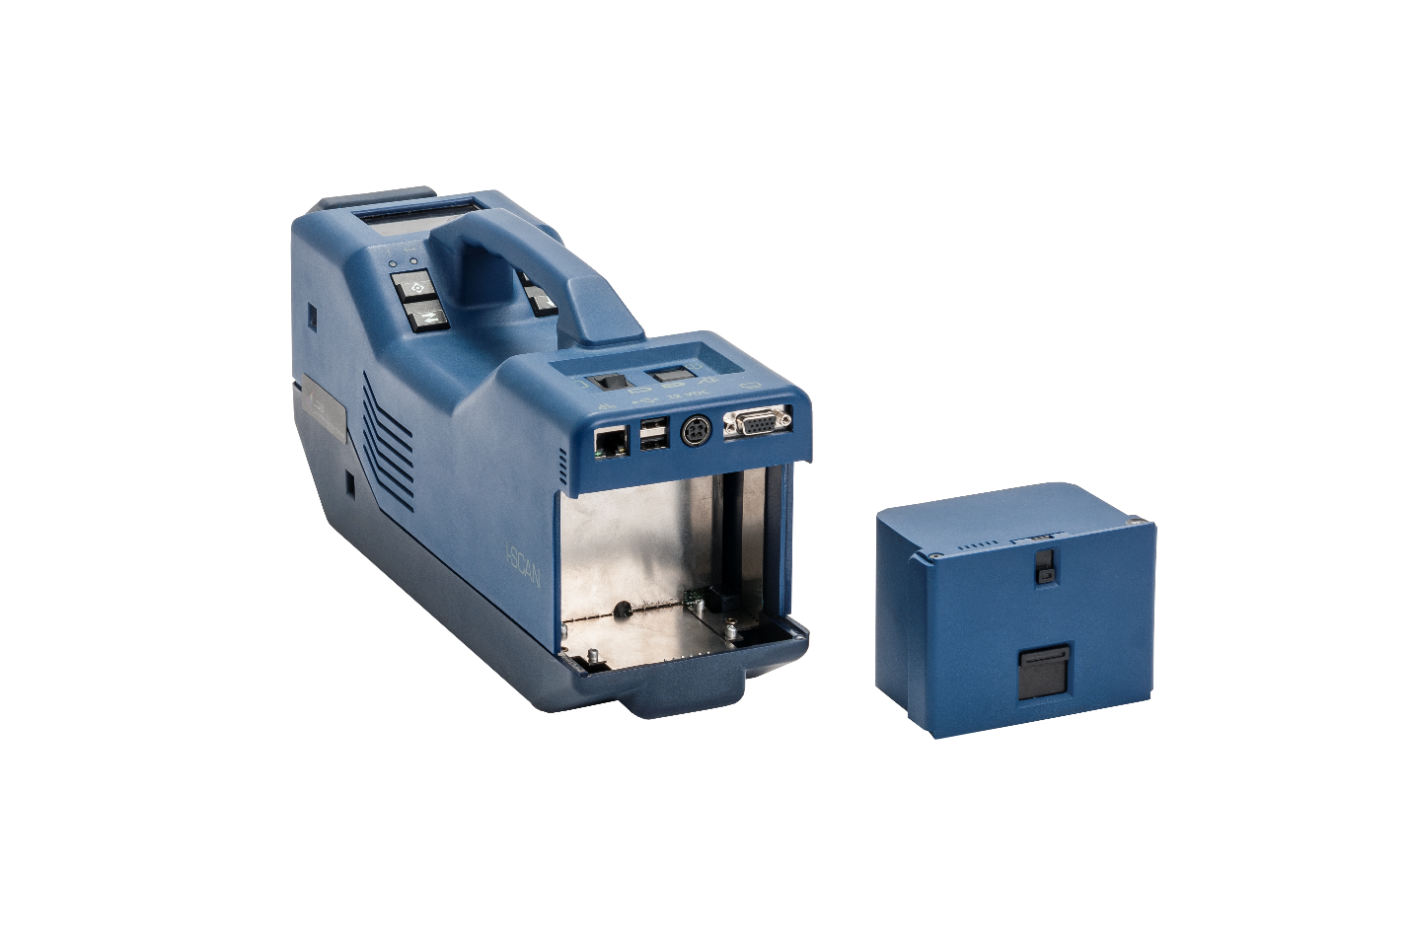
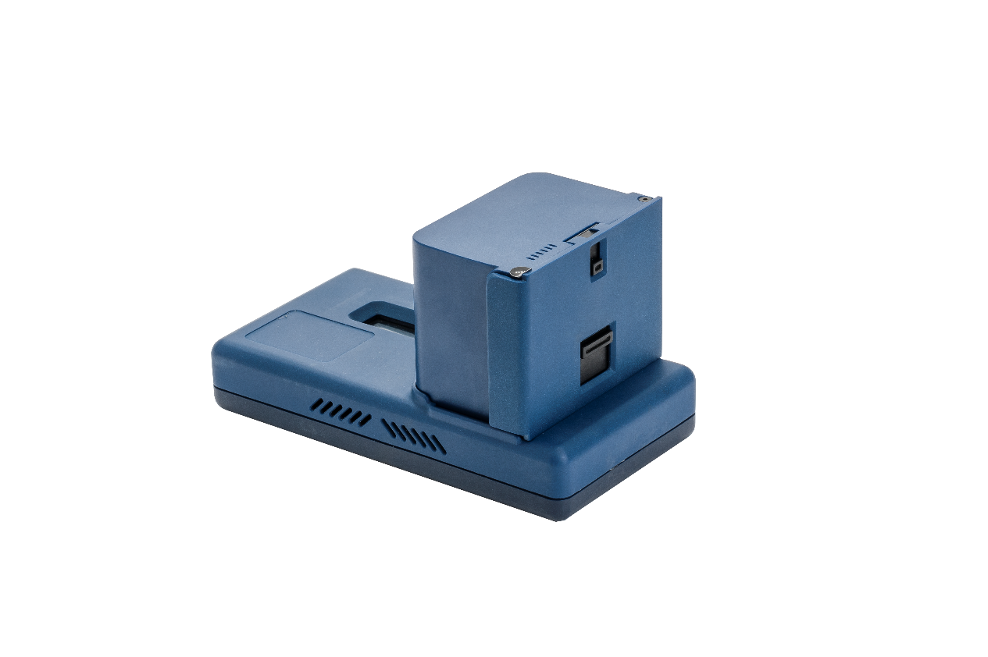
New “Hot Battery Swap”
i-Scan Mk.2 allows the user to replace battery without switching the device off (no farther warm-up time needed).
90 Sec to replace batteries without turning the device of
Spare battery pack & extra charger
4 hours of operating the device using the same battery pack

Slide 50




Device level- advantages
Very sensitive detection:
1 x 10 ^-11
1 x 10 ^-14
Low consumable:
1) Filter
2) Aluminum foil
3) Calibration
Non-Radioactive ionization source
Short warm up (15 Min) and cleaning (3 Min) time.
Simultaneous detection of positive and negative ions

Slide 51

Specifications
Feature | Value
Overall dimensions of the detector | 110×170×410 mm
Weight, with batteries | 3.7 kg
Measurement range of normalised (reduced) mobility of analysed ions | 0.5 – 3.0 сm²/V s
Detection range of low-volatile organic substances based on 2,4,6-trinitrotoluene (ТNТ) | 0.1·10⁻¹¹ – 200·10⁻⁷ g
Threshold for detecting low-volatile organic substances based on 2,4,6-trinitrotoluene (ТNТ)
- particulate matter, not less | 1.0х10⁻¹¹ g
- based on vapours, not less | 1.0х10⁻¹⁴ g/сm³
Time for operating mode start-up | ≤ 15 min
Measurement time | ≤ 5 s
Time of changing the type of analyzed ions (negative or positive),
- in unipolar mode (manual switching), sec | 10
- in bipolar mode (automatic cyclic polarity change), sec | 0.2
Time of detector cleaning, under normal operating conditions, not more | 3 min
Possibility of false response, %, not more | 1
Time of continuous autonomy work with regular battery, hours, not less | 4
Time of detector cleaning under regular operating conditions, min, not more | 3
Power supply
In-built accumulation batteries | 12 V
Power input | 220 V
Operational conditions
Temperature | 0-50°С
Relative humidity | 30-95 %

Slide 52
Hybris Kit Review (G-Scan + I-Scan)

Slide 53
Hybrid Kit Hybrid Kit advantages and Operational importance
The importance of providing the field officers and operators Hybrid capability comprises of both IMS detector and Laser detector is as follows:
The two technologies complete one another.
Together they cover the complete possible range of threats – Hidden or camouflaged; Direct contact or sealed in a container;
Together they cover the complete possible range of Hazardous materials – Thousands of hazardous materials. Each detector with its unique Database.
Together they cover the complete range of state of aggregation – Liquid, Bulk, Powder, Gels
Full depth identification: IMS detection is of the Chemical group level and Laser detector identification is at the molecule level.

Slide 54
Video Clips
For LDS video clips you are welcome to visit LDS YouTube channel
https://www.youtube.com/channel/UC_K8PtIqumS2pUvszMYb7Fw

Slide 55


Slide 56
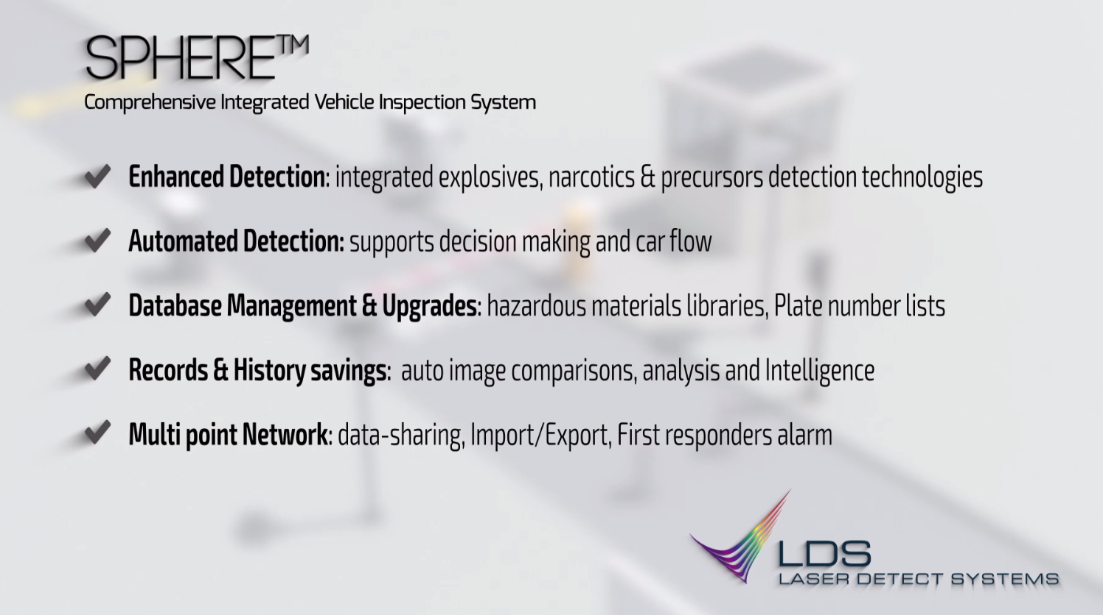

Slide 57
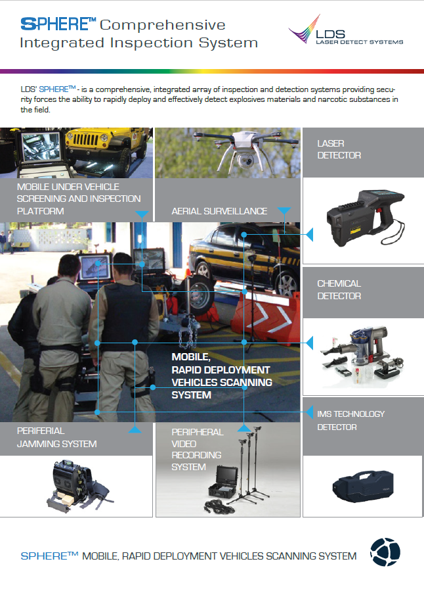
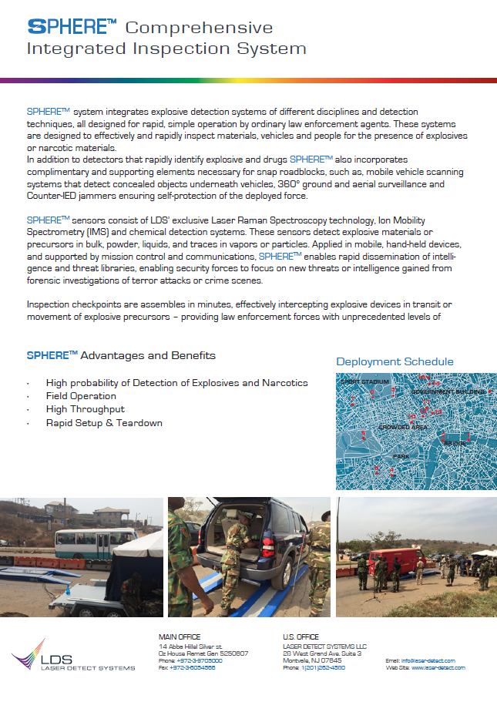
SPHERE

Slide 58
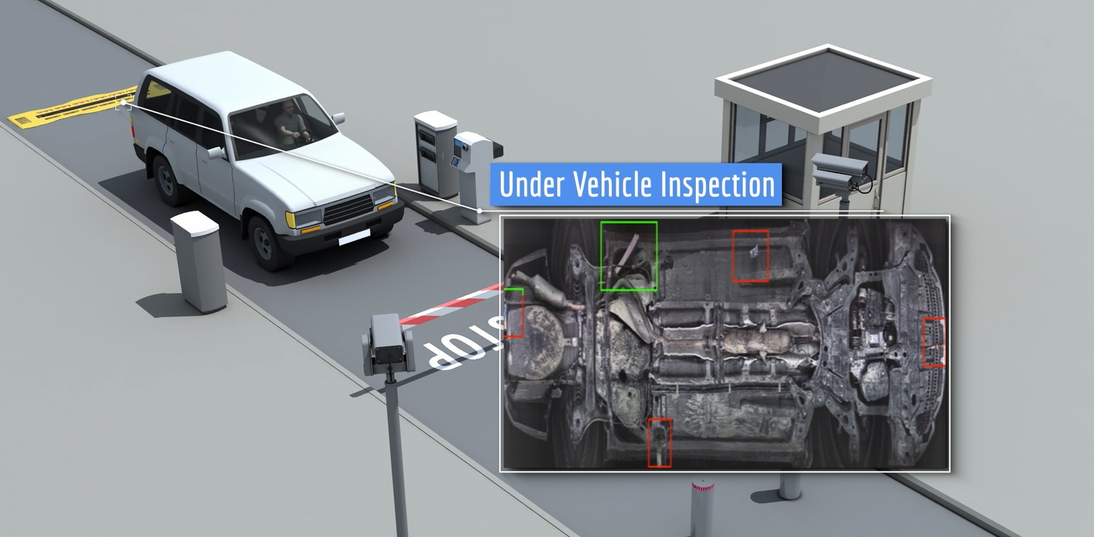

Slide 59
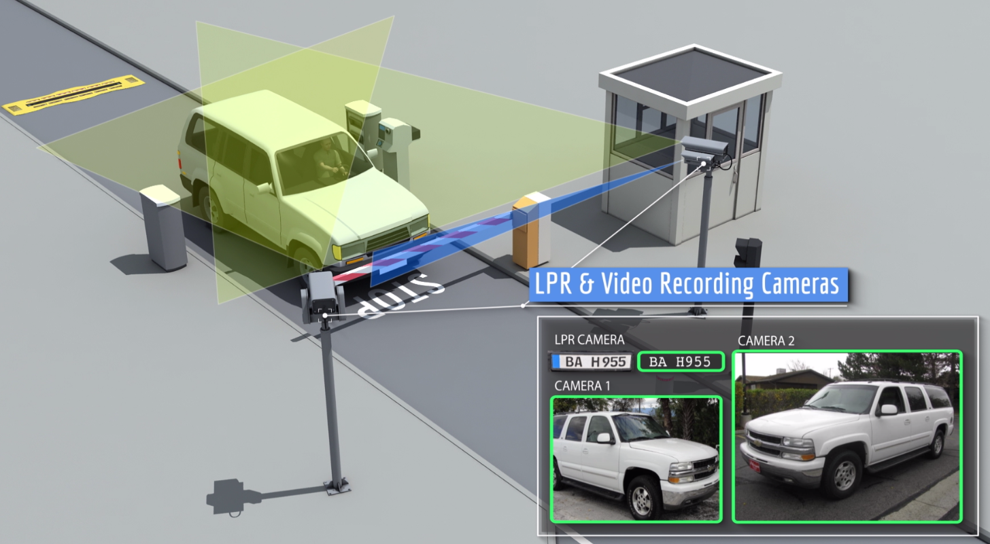

Slide 60
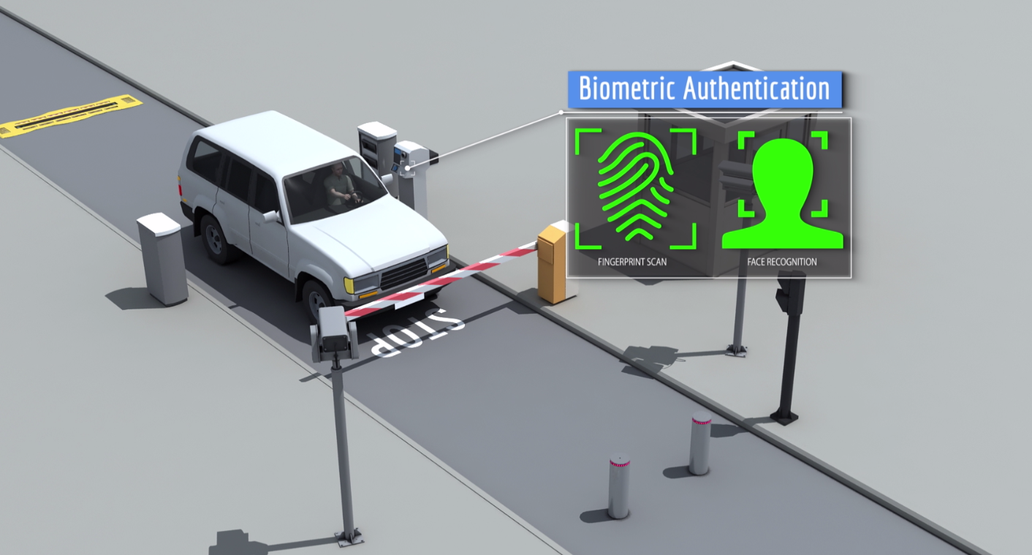

Slide 61


Slide 62


Slide 63
R&D

Slide 64

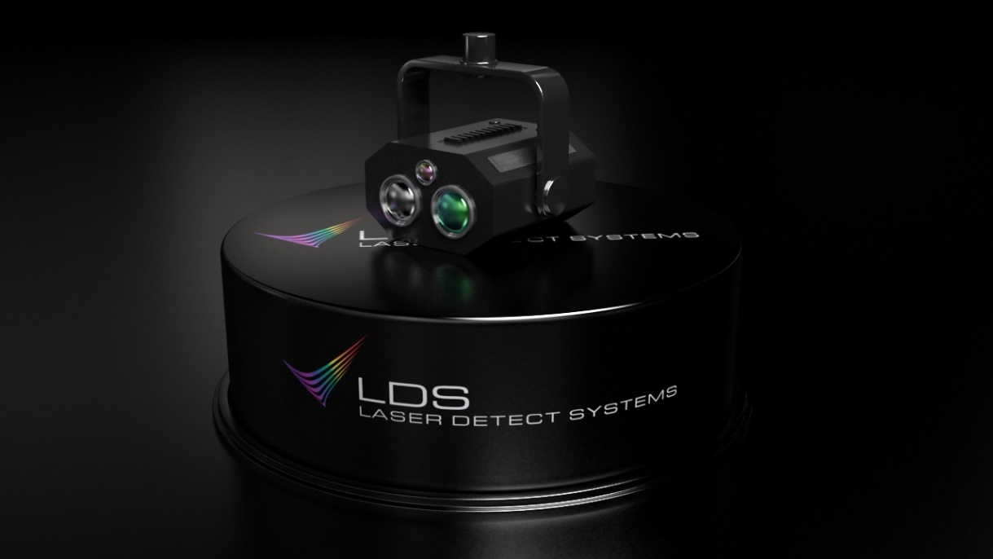
LDS R-SCAN SR mounted on a robot
Used for military missions - IED detection
Deep UV Remote Laser Sensing
Detection of micro grams up to 2 meter
Automatically Investigate critical points on different surface
R&D phase completed successfully
Analysis result integrated into the C2 panel
Extendable Database and libraries (S/W)
Option: jammers, night vision

Slide 65




New Development : The SpectroDrone
LDS – Laser Detect Systems ltd
Investors Presentation
www.laser-detect.com

Slide 66
Civil Applications

Slide 67




LDS - Civil Applications
Counterfeits Detection:
(Through sealed container)
Alcohol
Virgin Oil
Drugs
Crude oil inspection (SGS)

